Slide 1
What Functions are Kernels?
For some functions K(x_{i},x_{j}) checking that
K(x_{i},x_{j})= φ(x_{i}) ^{T}φ(x_{j}) can be cumbersome.
Mercer’s theorem:
Every semi-positive definite symmetric function is a kernel
Semi-positive definite symmetric functions correspond to a semi-positive definite symmetric Gram matrix:
K(x₁,x₁) | K(x₁,x₂) | K(x₁,x₃) | … | K(x₁,x_{N})
K(x₂,x₁) | K(x₂,x₂) | K(x₂,x₃) |  | K(x₂,x_{N})
… | … | … | … | …
K(x_{N},x₁) | K(x_{N},x₂) | K(x_{N},x₃) | … | K(x_{N},x_{N})
K=
Contains all necessary information for the learning algorithm

Slide 2
Inner product and Similarity
The class of kernel methods implicitly defines the class of possible patterns by introducing a notion of similarity between data. They explit the information about the the inner products between data items. If kernel given, no need to specify what features of the data are being used.
nv1=v1/norm(v1)
nv2=v2/norm(v2)
nv3=v3/norm(v3)
s12=nv1'*nv2
s13=nv1'*nv3
s23=nv2'*nv3
V1= [1 12 8 2 7 2]’
V2=[1 7 5 1 4 1]’
v3= [6 1 4 9 1 7]’
s12 = 0.9982
s13 = 0.4023
s23 = 0.4052

Slide 3
Inner product and Similarity
Text documents of 3 politicians’ speeches during election
Terms | 1 | 2 | 3
health 15 lakhs Tea seller Education 56’’ chest water | 1 12 8 2 7 2 | 1 7 5 1 4 1 | 6 1 4 9 1 7
V1= [1 12 8 2 7 2]’ v2 and v3 are also same as
in last slide
 | V1= [1 12 8 2 7 2]’
s12 = 0.9982
s13 = 0.4023
s23 = 0.4052
It seems the speeches 1 and 2 are by the same politician!

Slide 4
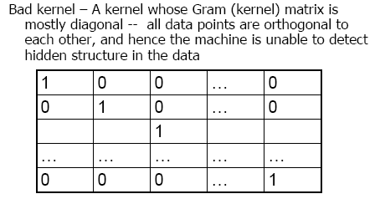
Kernels
• The kernel matrix is symmetric positive definite. • Any symmetric positive definite matrix can be regarded as a kernel matrix, that is as an inner product matrix in some space.
In mapping in a space with too many irrelevant
features, kernel matrix becomes diagonal

Slide 5
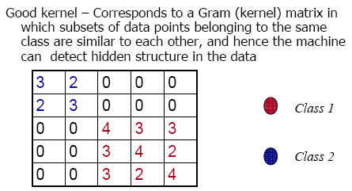
Kernels
http://www.kernel-machines.org/

Slide 6
MultiClass SVMs
One-versus-all
Train n binary classifiers, one for each class against all other classes.
Predicted class is the class of the most confident classifier
One-versus-one
Train n(n-1)/2 classifiers, each discriminating between a pair of classes
Several strategies for selecting the final classification based on the output of the binary SVMs

Slide 7
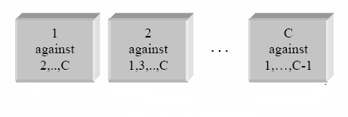
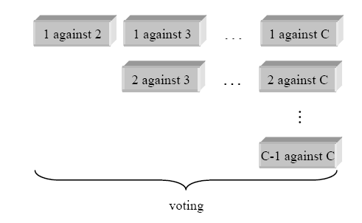
Total C classes
One-versus-all (OVA)
Total C binary SVMs
One-versus-one
All-vs-all (AVA)
Total C(C-1)/2 binary SVMs

Slide 8
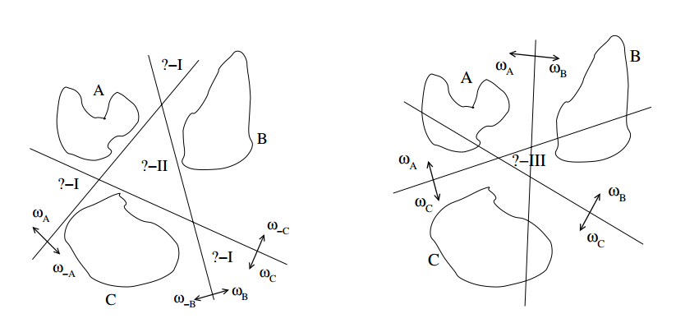
OVA
AVA

Slide 9
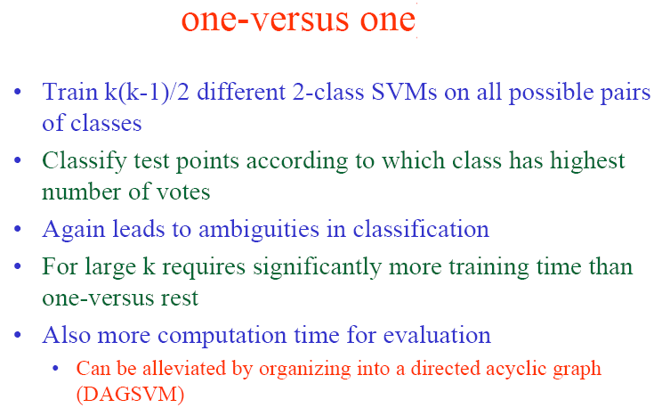

Slide 10
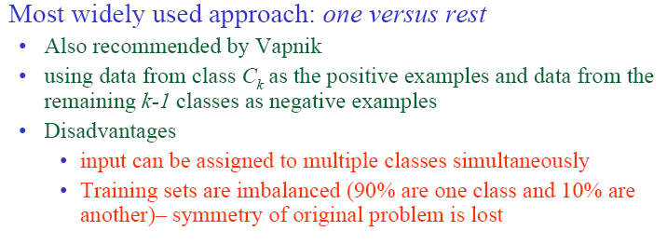
We studied 2 methods for multi class classification: one versus all (one versus rest) and one versus one. The third method is DAGSVM

Slide 11
Directed Acyclic Graph SVM (DAGSVM)
A Directed Acyclic Graph (DAG) is a graph whose edges have an orientation and no cycles.
Decision Directed Acyclic Graph (DDAG) contains N(N-1)/2 nodes, each with an associated one against one classifier.
Number of leaf nodes are N

Slide 12
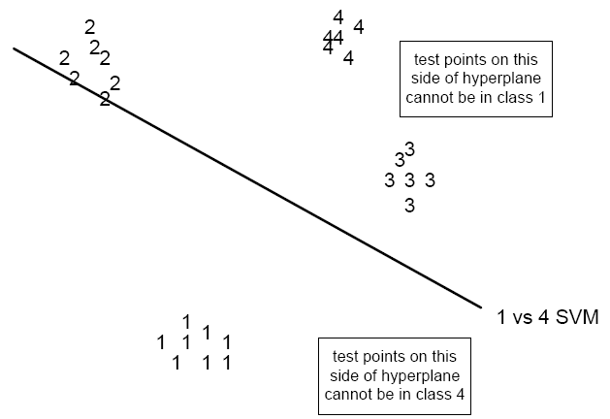
A 4-class classification problem

Slide 13
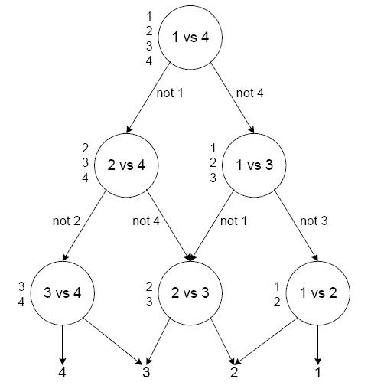

Slide 14
To evaluate a particular DDAG , starting at the root node, the binary function at a node is evaluated.
The node is then exited via the left edge, if the binary function is zero; or the right edge, if the binary function is one.
The value of the decision function is the value associated with the final leaf node.
The list is initialized with a list of all classes.
A test point is evaluated against the decision node that corresponds to the first and last elements of the list.
If the node prefers one of the two classes, the other class is eliminated from the list, and the DDAG proceeds to test the first and last elements of the new list.
The DDAG terminates when only one class remains in the list.

